Slide 1
NextGen Advisory Council
April 2026

Slide 2
NEXTGEN ADVISORY COUNCIL (NGAC) STRATEGIC PRIORITIES
Create a tailored focus to enhance engagement and empowerment of NextGen graduates
Support NextGen connection with the Association & Foundation and USAFA mission elements, with support for specific projects, as appropriate
Facilitate NextGen participation at both national and local levels
Enhance existing practices with a specific NextGen focus
Build an engaged recruiting pipeline for future AOG and Foundation board directors
Offer recommendations to the Board and Staff in support of NextGen integration
Notes:
These came from our finalized NGAC Charter (on Basecamp)

Slide 3
JUNE 2025
NGAC ESTABLISHED
NEXTGEN ADVISORY COUNCIL AND TIMELINE
A vanguard of 23 graduates (from 1997 – 2019) leading across active duty, reserve, guard, and civilian sectors.
4-30 JUNE 2025
NEXTGEN SURVEY
Partnered with industry research expert to facilitate survey of 5K randomly selected NextGen (1995 to current) graduates, graciously funded by Jerry Bruni Graduate Engagement Fund.
14 JULY 2025
NGAC BRIEFED SURVEY RESULTS
Four leading statistically-based themes emerged (post active-duty work, support for grads in need, social activities, and professional development/mentorship).
SEPTEMBER 2025
NGAC SUBCOMMITEES FORMED
Mentorship
Career/Life Transitions
Social Connection/Activities
16-18 OCTOBER 2025
NGAC ACTIVITIES
NGAC board presentations and meeting to plan remaining efforts for 2025 and map out 2026.

Slide 4
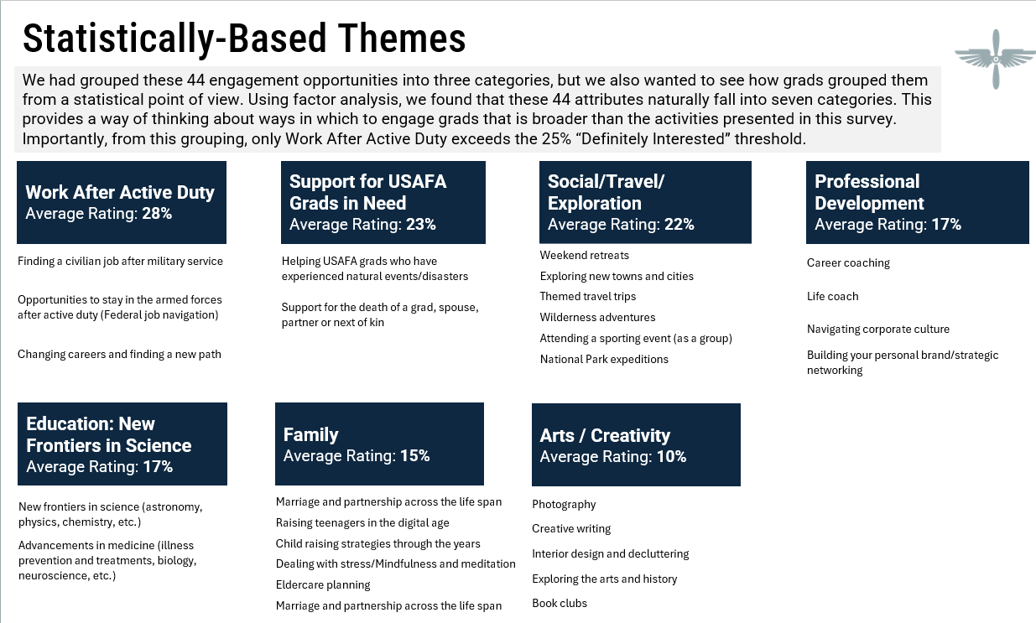
Using 2022 grad survey data, NGAC focused on the top four themes initially.
They further narrowed down to three with the decision that the Association & Foundation would best address “Support for USAFA Grads in Need.”
Notes:
This was from the presentation Karl Weiss, Market Perceptions Founder gave to us, and made available to both boards.

Slide 5
NextGen: From Insight to Activation
NextGen Survey Top Themes:
Work after Active Duty (28%)
Support for Grads in Need (23%)
Social Activities (22%)
Professional Development (17%)
2026 Engagement Roadshow:
Meeting Grads Where They Live, Work and Serve.
Notes:
Italicized item—NGAC viewed AOG role to work and prioritized initiatives that align with core A&F mission pillars and measurable engagement outcomes

Slide 6
NGAC Sub-Committees formed to address top concerns
Career Transitions
Host NextGen Presents webinars
Serve as connections into industries
Mentorship/Professional Development
Accessible via usafa.org website
Volunteer as mentors for fellow graduates and cadets
Social Activities & Communication
Next-Level Networking events
Support chapter-led events when possible
Space (Feb)
Cyber (Mar)
Wealth Management (Apr)
Real Estate (May)
Active on social channels to promote USAFA and A&F
NextGen emails

Slide 7
Early wins and opportunities to improve
Early Wins
More recent grad participation (over 80% of participants 1995 and more recent)
Additions to Chapters’ leadership boards with more recent grads (i.e., LA Chapter)
Over 100 registrants for each webinar; 3x viewers once webinars recorded and shared
Opportunities to Improve
Earlier and proactive planning with Chapters
Working more closely with CAS reps from NextGen classes
Activating NextGen graduates to update contact information to help drive engagement and connection with USAFA and fellow alumni

Slide 8
https://usafa.org/nextgen-advisory-council

